Slide 1
Action Extraction
Kaiqi Zhao
Mar 28th , 2012

Slide 2
Outlines
Objective of Action Extraction
Framework
Action Extraction
Action Clustering
Next Delivery

Slide 3
What is action?
Action
Action is a verb and a set of arguments corresponds to the verb.
Arguments include subject, object, indirect object and other prepositional arguments.
Example: Google buys Motorola
Action cluster
In an action cluster, all of the actions have the same kinds of arguments.
For the same argument, all the instances are semantically in the same class.
Example: Company buys company
Google buys Motorola
Microsoft buys Skype
company
buy
company

Slide 4
Why do we need action?
Disambiguate noun phrases
He play a cd.
Enter cd to change the directory.
Disambiguate verbs
The concert will be held in Tokyo Dome.
Sam holds an iPad.

Slide 5
Outlines
Objective of Action Extraction
Framework
Action Extraction
Action Clustering
Next Delivery

Slide 6
Framework
Our goal
Build a model to classify a given action to a particular action cluster. We need the following two steps:
Action extraction from a large corpus.
Action clustering to get action clusters.
verb
sentences
Action Extraction
Actions
Probase
Action Clustering
Action clusters
Fig 1. Work flow of the frame work

Slide 7
Probase
An is-a relationship knowledge base extracted from Hearst patterns.
Is-a relationship (entity-concept relation):
More information:
http://www.cs.sjtu.edu.cn/~kzhu/papers/probase.pdf
fruit
company
food
fresh fruit
brand
1023
525
207
2099
202
apple
Fig 2. Concepts of “apple” in Probase

Slide 8
Outlines
Objective of Action Extraction
Framework
Action Extraction
Action Clustering
Next Delivery

Slide 9
Action Extraction
Input: A large sentence set, a given verb list
Output: a set of actions (verb + arguments)
Method:
Filter complicate and bad sentences.
Run deep parsing on sentences to get dependency information
Design action extraction rules from the Stanford Dependency output of Stanford Parser
Stanford Parser gives the head word of each argument, we have to find Probase entities within a sliding window

Slide 10
Filtering Sentences
Get sentences in neat format. Sentence which satisfy all of the following conditions will be kept.
Length of the sentence is between 30 and 200
Starts with capital letter and ends with one punctuation “.”
Has more than 6 and less than 20 words
Contain no more than 6 characters which are not letters, numbers or punctuation.
Contain no more than 4 pure non-letter words or invalid single-letter words
No more than 10 numbers
Contain at least one verb
Contain at least one Probase concept
Less than 50% words are full upper-cased words.
Contain special character like ‘/’ or ‘\’.

Slide 11
Stanford Dependencies
Subject:
nsubj(verb, subj_head)
nominal subject
E.g. Sam ate an apple. nsubj(ate, Sam)
agent(verb, subj_head)
complement of a passive verb.
E.g. The man is arrested by police. agent(arrested, police)
Object:
dobj(verb, obj_head)
direct object
E.g. He gave you a book. dobj(gave, book)
nsubjpass(verb, obj_head)
Passive nominal subject
E.g. The man is arrested by police. nsubjpass(arrested, man)
Indirect Object:
iobj(verb, iobj_head)
Indirect object
E.g. He gave you a book. iobj(gave, you)
Phrasal verb particle
prt(verb, particle)
Verb particle of the verb phrase
E.g. Pick up the ball. prt(pick, up)

Slide 12
Stanford Dependencies
Some extraction rules on dependencies:
For active voice, subject must be on the left to the verb which object must be on the right to the verb.
For passive voice, object must be on the left to the verb.
“agent” must co-occur with “nsubjpass”. E.g. The book is written by Shakespeare.
“indirect object” must co-occur with “object”
For more Stanford dependencies:
http://nlp.stanford.edu/software/dependencies_manual.pdf

Slide 13
Find Probase Instance
We can get the argument by using the head word obtained form dependency tree.
Example:
Sentence: They join vigorously, liberating much heat as they burn with a pale green flame.
Get the argument with preposition “with”:
burn
prep_with
However, a pale green flame is not a Probase entity. What we want to get from here is flame.
flame
det
amod
a pale green flame
amod
a
pale
green
Fig 3. dependency tree of an argument of “burn”
We get Probase instance by using a sliding window with an initial size of the whole phrase (a pale green flame) and decrease the size in each iteration.

Slide 14
Refine Extraction Results
Convert plural forms to singular forms
Convert if not all the words are capital.
Convert each word to singular in the phrase. E.g. bags of apples → bag of apple
Remove quantifier and article
Remove if not all the words are capital.
two woman → woman

Slide 15
Evaluation of Action Extraction
162M sentences (1/40 scale) are obtained by using the filtering criteria. 103M actions are extracted from these sentences.
Two evaluation measures are used:
M1: An action is considered to be correct when the subject, object, indirect object are correct.
M2: An action is considered to be correct when all of the arguments are correct.
Labeled 100 sentences, the precision of action is:
M1: 92.72%
M2: 83.64%

Slide 16
Outlines
Objective of Action Extraction
Framework
Action Extraction
Action Clustering
Next Delivery

Slide 17
Action Clustering
Input: Actions for a given verb
Output: Action clusters for the given verb.
Method:
Filter vague entities and big concepts
Group actions with the same argument pattern to initial clusters.
Example:
Cluster 1 (subj, obj): Engine burn fuel, acid burn skin.
Cluster 2 (subj, obj, with): He burn house with fire.
In each initial cluster, do K-means clustering on each argument by using is-a relation P(c|e) to build the concept vector.
After K-mean clustering, we have a cluster signature for each action. The signature is like: (subj: 1, obj: 0). Group the actions with the same signature to form the final clusters.
Conceptualize each argument of the action clusters.

Slide 18
An Example of Action Clustering
burn house
burn house with fire
burn building
face burn
cheek burn
fuel burn
gas burn
burn house
burn building
burn house
burn building
burn house with fire
burn house with fire
face burn
cheek burn
fuel burn
gas burn
face burn
cheek burn
fuel burn
gas burn
Step 1. Group by argument type
Step 2. Clustering on each argument
Fig 4. An example of action clustering

Slide 19
Filter Vague Entities & Big concepts
Objective
Big concepts such as “thing”, “area”, “item”… will affect the correctness of distance between two entities.
E.g. “access” and “food”. The top 5 common concepts are big concepts: “thing”, “item”, “issue”, “product”, “factor”. This makes them similar on the concept vector space.
Vague entities such as “education”, “poverty”, “safety” are very abstract, and not well understood by “such as” or “is a” pattern.
E.g. “education”. The top 5 hypernyms of education are “factor”, “issue”, “area”, “service”, “sector”.
Strategy of filtering
Filter big concepts using a black list.
Filter entities with more than 50% of top 20 hypernyms are big concepts.

Slide 20
Kmeans Clustering
Problems
Outlier problem: Each data point will have a cluster label in Kmeans, even though points which are far from any cluster (outlier). We have lots of outlier in the data which may come from extraction errors and wrong expression in natural language.
Initial centers: In common cases, the initial centers of Kmeans are randomly picked from the data points. The result are strongly depend on the initial status.
Modification on Kmeans
Remove outlier at the beginning by looking at the distance to other data points.
Rank the data points by frequency, scan the points sequence to find the k-th center, which has the maximum distance to its nearest center of the previous k-1 ones.
After clustering converges, label data points far from any of the cluster centers as outliers.
The 3rd center
Fig 5. Finding the 3rd initial center

Slide 21
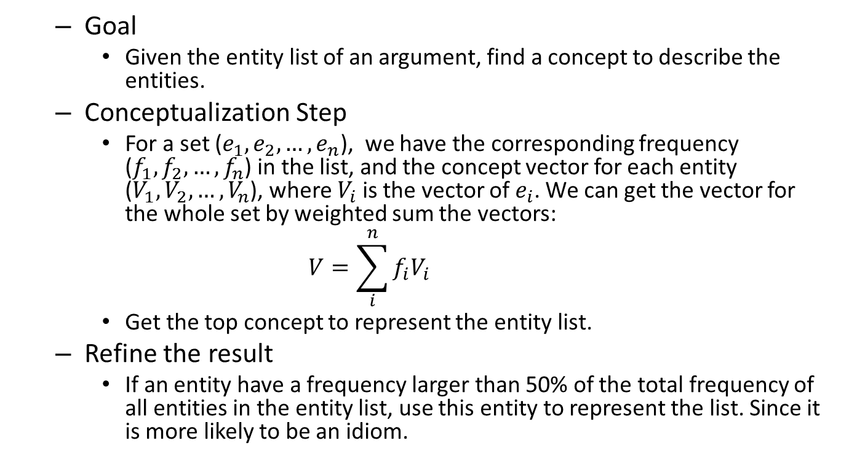
Argument Conceptualization
Goal
Given the entity list of an argument, find a concept to describe the entities.
Conceptualization Step
For a set ($e_{1},e_{2},…,e_{n}$), we have the corresponding frequency ($f_{1}, f_{2}, …,f_{n}$) in the list, and the concept vector for each entity ($V_{1}, V_{2}, …,V_{n}$), where $V_{i}$ is the vector of $e_{i}$. We can get the vector for the whole set by weighted sum the vectors:
$$V=\sum_{i}^{n}{f_{i}V_{i}}$$
Get the top concept to represent the entity list.
Refine the result
If an entity have a frequency larger than 50% of the total frequency of all entities in the entity list, use this entity to represent the list. Since it is more likely to be an idiom.

Slide 22
Result Display
Play, Pattern: V Obj
Id | Verb phrase | Object | Instances
1 | play | sport | 12027
2 | play | instrument | 9853
3 | play | game | 7378
4 | play | genre | 2977
8 | play | company | 1293
9 | play | outdoor activity | 1137
13 | play | show | 919
14 | play | animal | 737
16 | play | file | 664
39 | play | heavy metal | 275

Slide 23
Result Display
Cluster of play sport
Cluster of play instrument
Verb phrase | Object | Frequency
play | football | 2053
play | golf | 1882
play | basketball | 1452
play | tennis | 1042
play | soccer | 1015
play | baseball | 877
play | hockey | 462
play | softball | 353
play | volleyball | 344
play | rugby | 259
Verb phrase | Object | Frequency
play | guitar | 2976
play | piano | 1893
play | drums | 650
play | violin | 497
play | bass | 406
play | flute | 262
play | trumpet | 218
play | saxophone | 151
play | banjo | 146
play | fiddle | 136

Slide 24
Result Display
eat, Pattern: V Obj
Id | Verb phrase | Object | Instances
1 | eat | food | 8849
2 | eat | snack | 3386
3 | eat | fruit | 2799
4 | eat | animal | 1683
5 | eat | ingredient | 1458
7 | eat | lifestyle change | 768
9 | eat | species | 586
11 | eat | organ | 532
14 | eat | pussy | 399
31 | eat | shit | 117

Slide 25
Result Display
Cluster of food
Cluster of snack
Verb phrase | Object | Frequency
eat | fish | 829
eat | egg | 365
eat | cake | 338
eat | ice cream | 318
eat | bread | 315
eat | chocolate | 315
eat | cookie | 257
eat | chicken | 252
eat | candy | 228
eat | pork | 226
Verb phrase | Object | Frequency
eat | pizza | 433
eat | sandwich | 260
eat | salad | 247
eat | sushi | 157
eat | chip | 156
eat | burger | 132
eat | popcorn | 114
eat | hot dog | 93
eat | hamburger | 85
eat | cupcake | 69

Slide 26
Outlines
Objective of Action Extraction
Framework
Action Extraction
Action Clustering
Next Delivery

Slide 27
Next Delivery
Find a better way to filter vague entities. For example, make use of the rank of hypernyms of entities.
We only use entities for clustering in the current experiments, and all of the concepts and vague entities became outliers, for example, “person”. We need to add outliers to the grouping process.
Optimize the argument conceptualization step.
Integrate verb synset of WordNet to map actions clusters to verb senses.

Slide 28
Thank you for attention!

